Slide 1
Holograms
Roger Rothenberg

Slide 2
Record of light scattered from an object
Same light field is ‘reconstructed’ without original object present
Requires laser for tight control of light source and light field
Appears 3-dimensional

Slide 3
‘Object’ beam
Beam is spread and illuminates scene to be recorded
‘Reference’ beam
Beam is directed to recording medium w/o scattering off of object
Beams create interference pattern on recording medium
When light similar to reference is shined on developed medium, it diffracts to produce a light field identical to light field of object beam

Slide 4
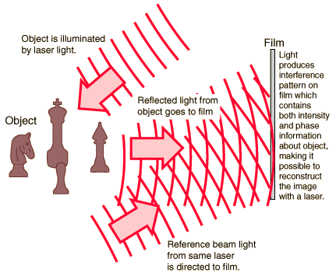
Holograms

Slide 5
Transmission Hologram
Reference beam and object beam on same side of holographic surface
Viewed by shining laser light through image side
Must be viewed by same wavelength light used to create

Slide 6
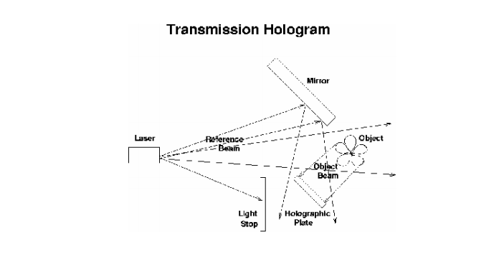
Transmission Hologram

Slide 7
Reflection Hologram
Reference beam and object beam come from opposite sides, shine on opposite surfaces
Visible without laser light
Require only white light to view

Slide 8
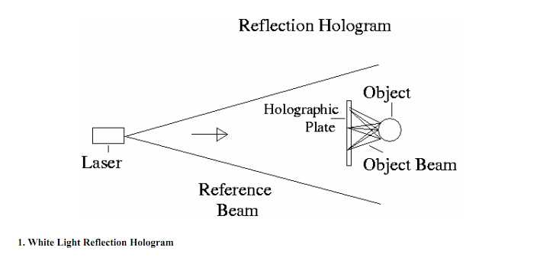
Reflection Hologram

Slide 9
Hologram Applications
Data Storage
Image Processing
Interferometric Microscopy
Security
E.g. Credit Cards, ID, Passports

