Slide 1
TOM PETTY IS DA BEST
By: Chiara (and Jake)
Notes:
This template can be used as a starter file for a photo album.

Slide 2
Tom petty
Introducing

Slide 3
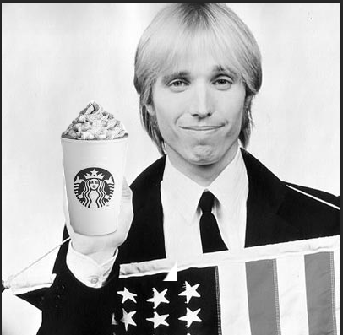
How We Met: The story begins….
Some old 63 year old guy, named Tom decided that one day he would marry me. We met at Starbucks. He was standing in front of me and he ordered my favorite drink, a pumpkin spice latte. Then he spilled it on me, he then said “OH NO I’M SO SORRY HERE ARE CONCERT TICKETS!!!!!!!!!!”
“It’s ok. Thank you! Are they front row tickets?” I responded.
“Yupo!” said Tom.
“Oh my gosh! Thank you so much! Can I have some VIP backstage passes to meet you after the show?” I asked.

Slide 4
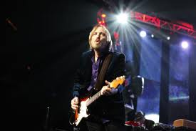
At The Show: The Story Continues…
At the concert Tom jumped into the audience and landed right next to me. Then wild fans ripped up his clothes and he screamed “I LIKE YOUR FACE WILL YOU MARRY ME?”
Then I started to say “YES!!!” a million times UncontrOllabY.
The crowd went WILD!!! They were so happy for us, they were crying tears of joy.

Slide 5
These are the reasons that Tom Petty is da best:
He has a beard
He is amazing at guitar
He knows Jon Bon Jovi
He be like “I like yOur FacE”
He wears sunglasses INSIDE
He has good quotes
And he is Funny

Slide 6
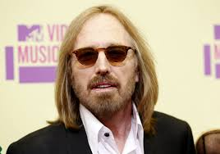
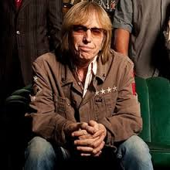
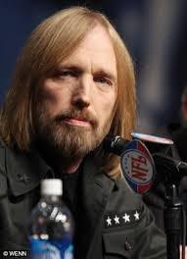
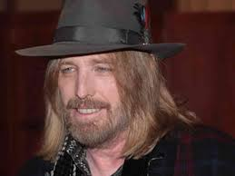

Slide 7
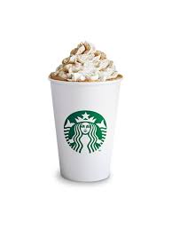
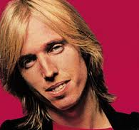
Mechanical Flower

Slide 8
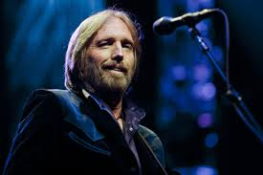
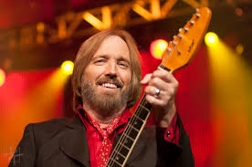
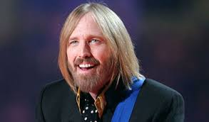

Slide 10
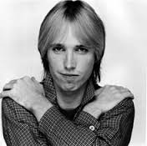
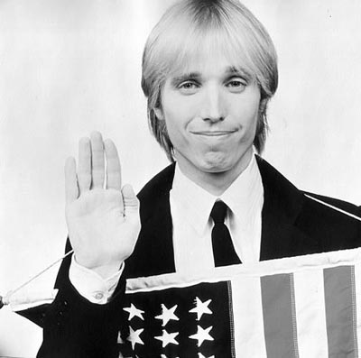
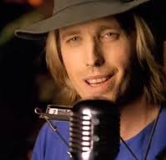
PROFESSIONAL
DYNAMIC
TOM
SOPHISTICATED
CREATIVE
PETTY

