Slide 1
Gianna’s favorite Stars
A history

Slide 2
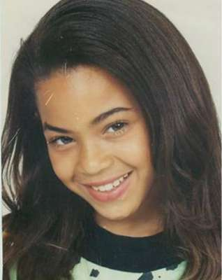
Beyonce
Born Sept. 4 1981, in Houston, TX.
Rose to fame in the late 90s as a member of Destiny’s Child

Slide 3
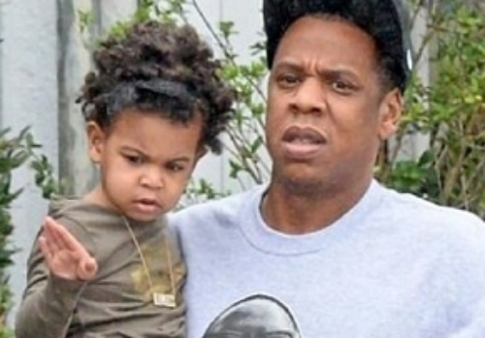
Beyonce
Married Shawn Carter, Jay-z, in 2008
Gave birth to Blue Ivy in Jan, 2012

Slide 4
Jay-z
Jay-z was born in Dec. 4, 1969
Grew up in Brooklyn, New York
Ranked as the best rapper
My favorite song is Empire State of Mind

Slide 5
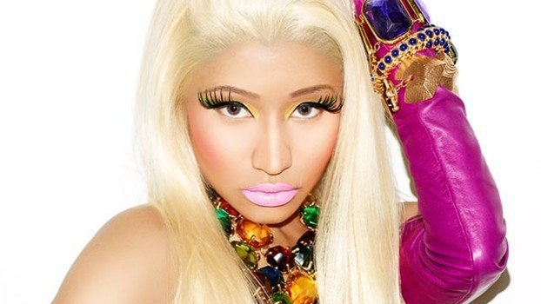
Nicki Minaj
Born Dec. 8 1982
Real name is Onika Tanya Maraj
She is a rapper, singer, and a actress
Born in Saint James
Moved to Jamaica Queens, New York when she was 5

Slide 6
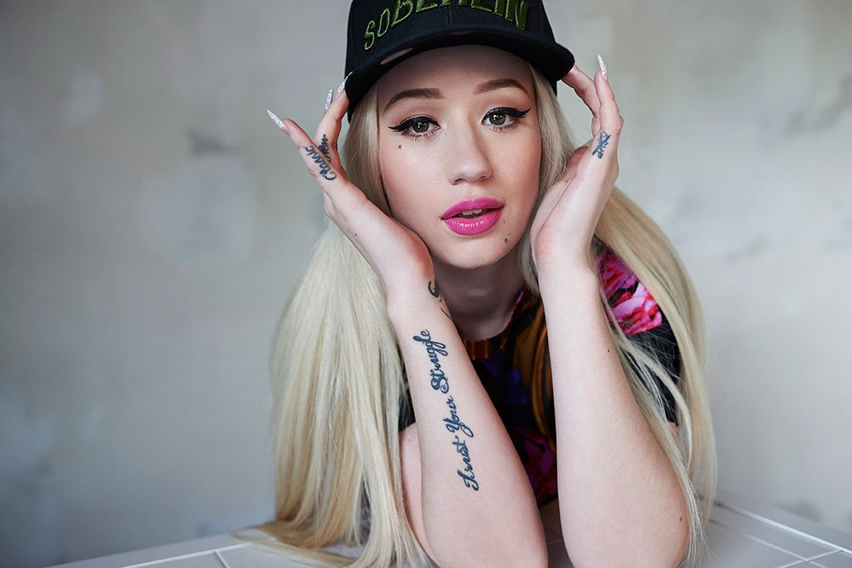
Iggy Azalea
Born June 7 1990 in Mullumbimby, New South Wales
Moved to Miami Florida when she was 16
A rapper

Slide 7
Kim Kardashian west
Born Oct. 21, 1980 in Las Angeles, Cal.
She has a tv show, Keeping Up With The Kardashians
Married to Kayne West
Gave Birth To North West on June 15, 2013

