Slide 1
A New Graphic Novel: The Prologue
By: Megan and Taylor
With support from: Eunice and Hannah

Slide 2
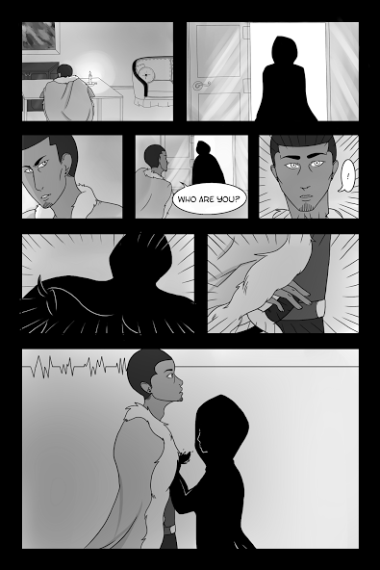

Slide 3
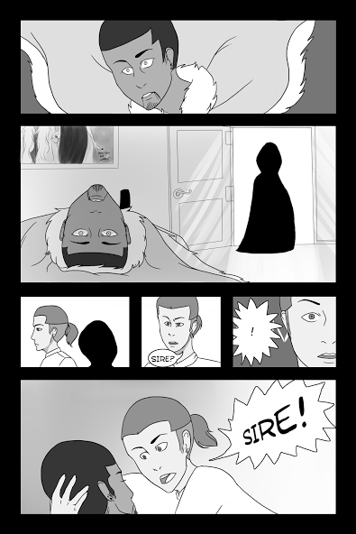

Slide 5
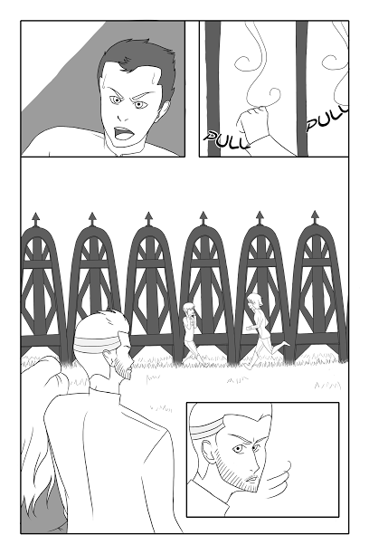

Slide 6
