Slide 1
Video games
My favorite

Slide 2
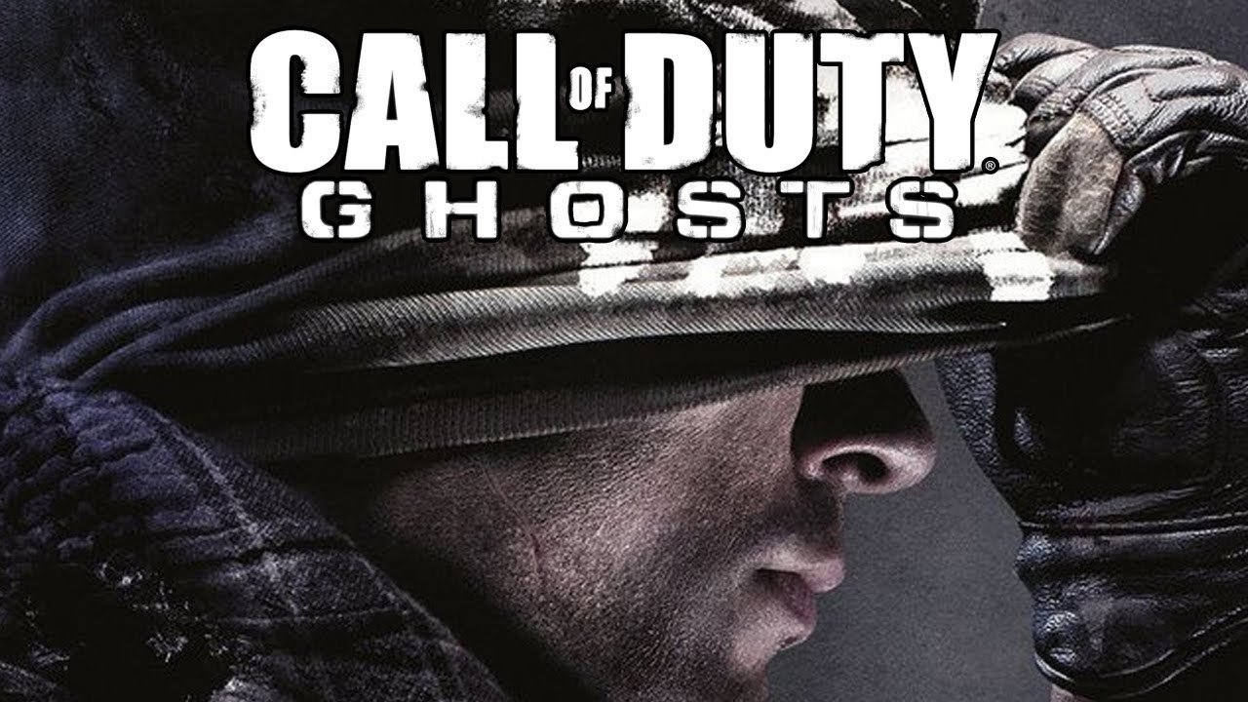
Call of Duty: Ghosts
There is a squad called the ghosts and there looking to take back the nation
It has some of the best graphics because it looks more realistic
You can play with your friends

Slide 3
Modern Warfare 3
In this game you can play multiple characters
It has better graphics than Black Ops 1

Slide 4
Black Ops II
The Black Ops are a squad like the ghosts
They are both made by Activision and Infinity Ward

Slide 5
Skate 3
You get to create a skater that becomes a pro
It’s similar to the Tony Hawk games

