Slide 1
How to Draw a Face
By Taylor

Slide 2
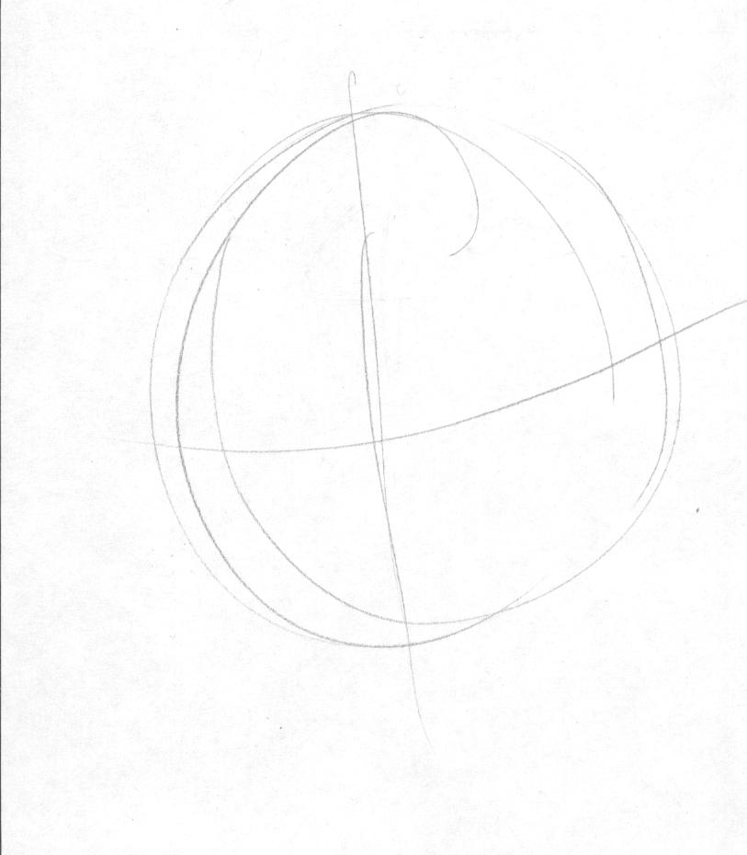
Step one
Sketch a basic circle, putting horizontal and vertical through the middle.

Slide 3
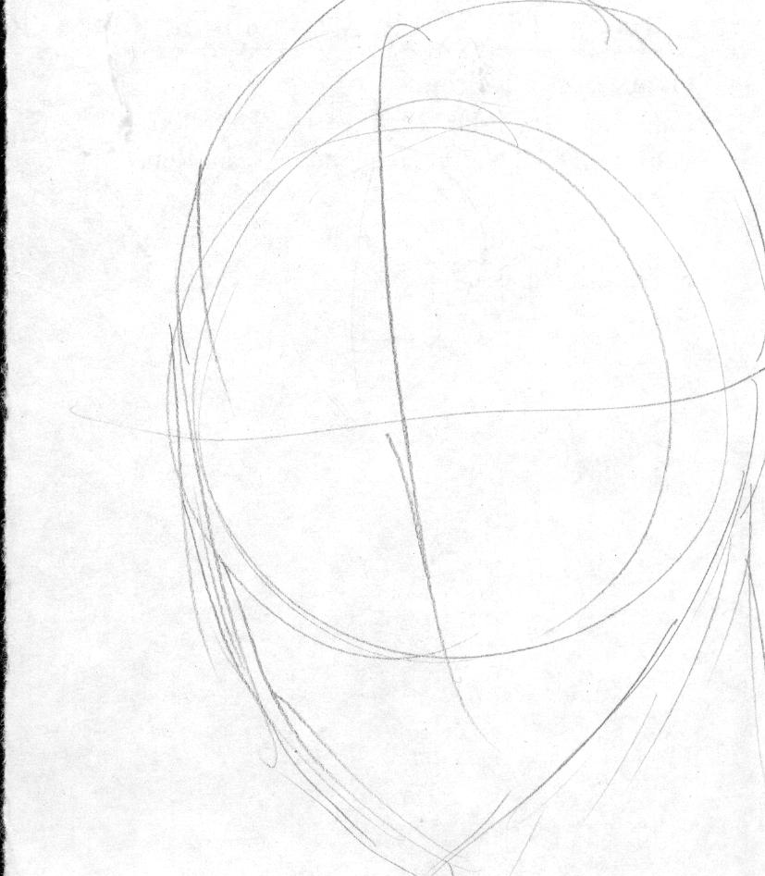
Step 2
Next, sketch a basic outline of the head using the circle. The chin goes below the bottom of the circle. Chins usually have a rounded out triangular shape.

Slide 4
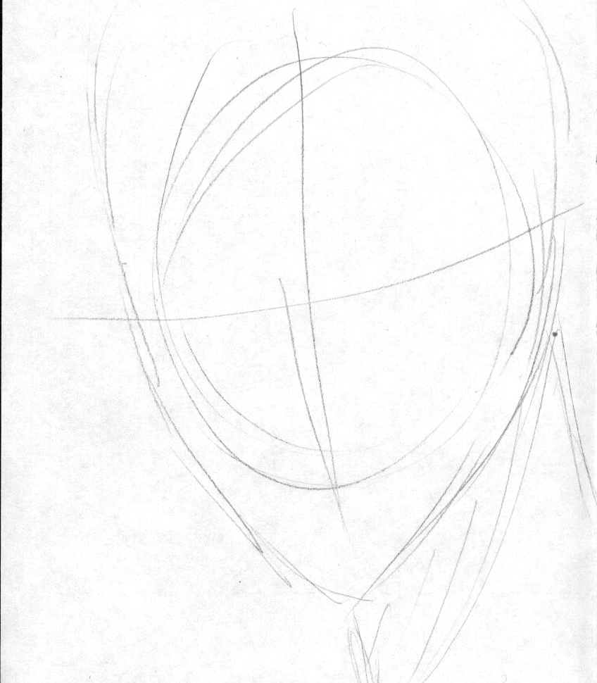
Step 3
Draw in the neck, it goes down starting at the back of the jawline and ends at the chin.

Slide 5
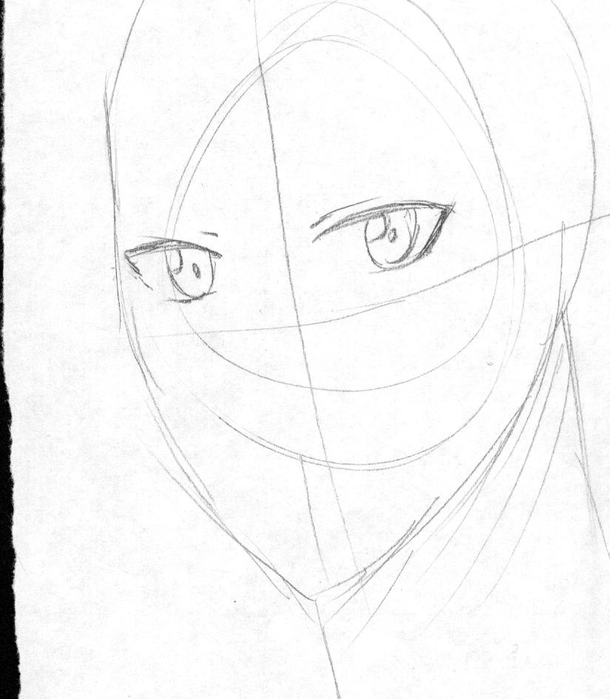
Step 4
Then, draw the eyes. Eyes should be above the horizontal lines. Eyelids go slightly above the upper eye line.

Slide 6
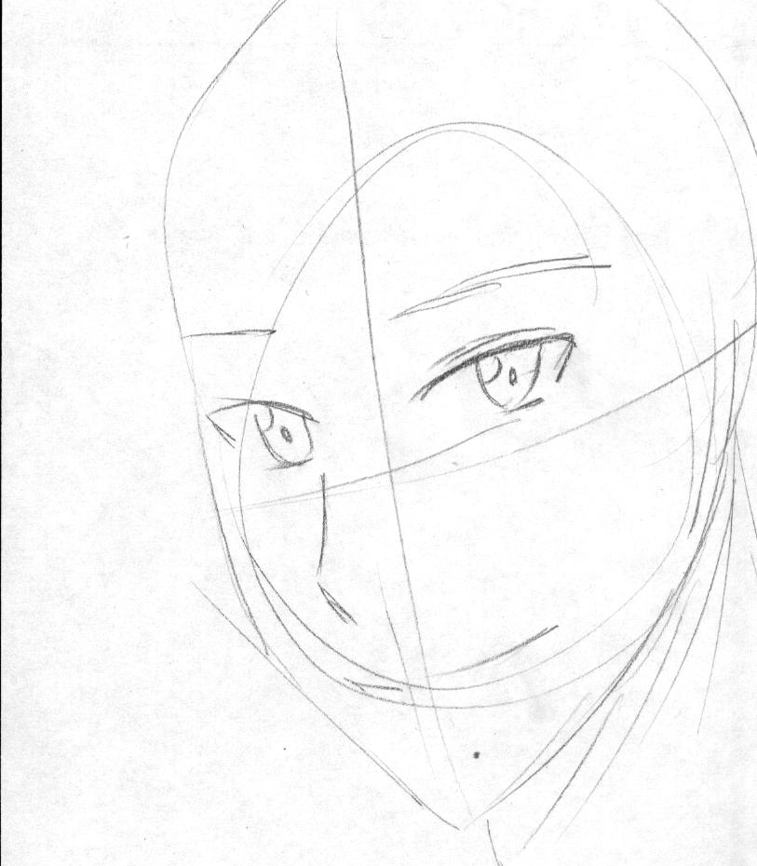
Step 5
Next, draw in the eyebrows. They should be placed at the bottom of the forehead. Then, draw in the nose. The nose should be centered in the middle of the face. Depending on the angle of the face, the nose point can be more exaggerated. Below the nose, draw in the mouth. The mouth should be placed slightly above the center between the end of the nose and chin.

Slide 7
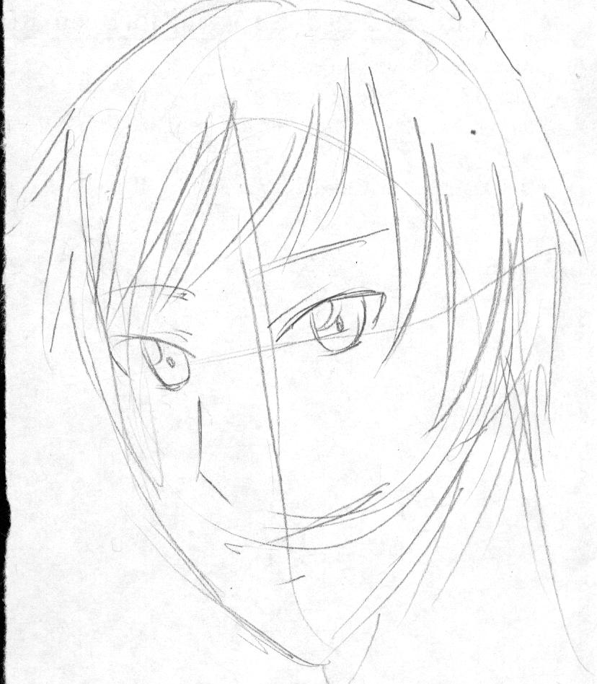
Step 6
Afterward, draw in the hair. Hair is not perfect; some strands are generally out of place.

Slide 8
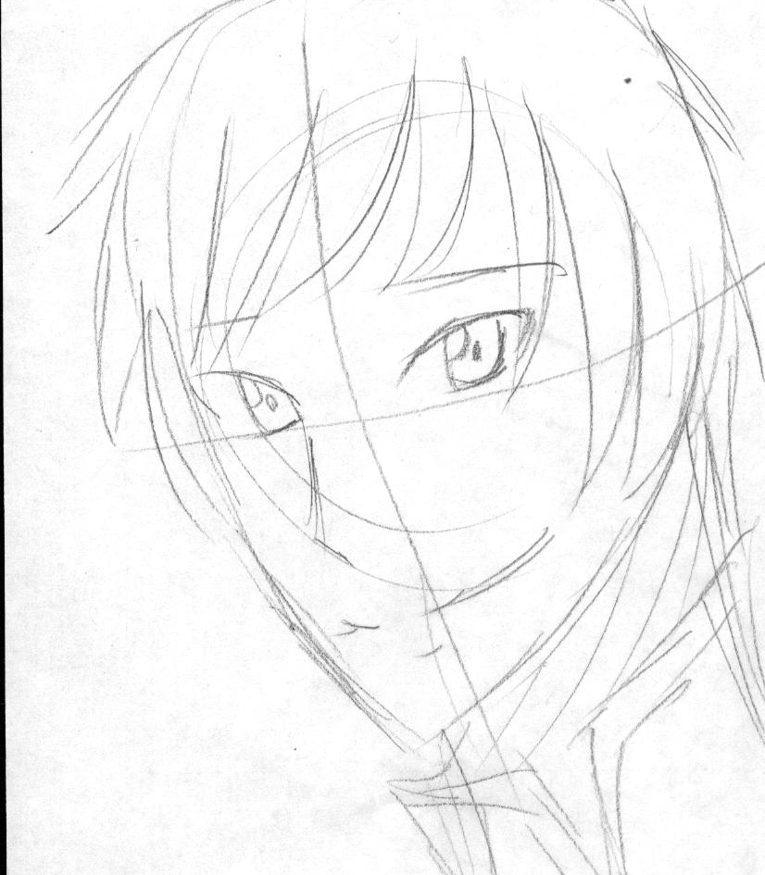
Step 7
Depending on the shirt type, draw in the collar of the top.

Slide 9
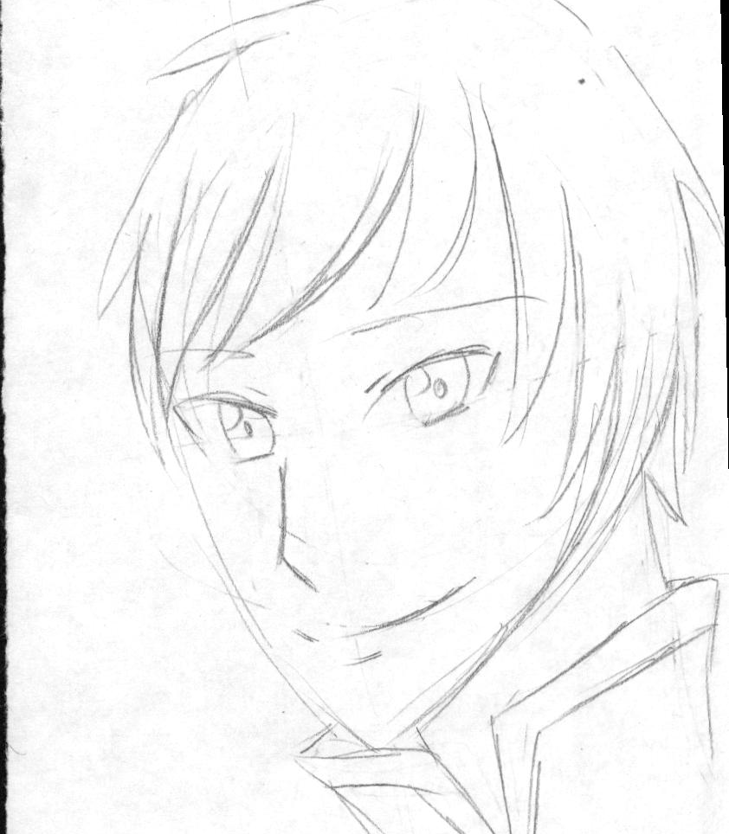
Step 8
Clean up the sketch using the eraser, fix some lines if necessary.

