Slide 1
We Are BEAUTIFUL
By: Shamel Campbell and Darielle Gadsby

Slide 2
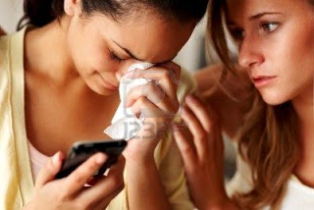
RELATIONSHIPS
No relationship should ever take away from who you are.
Stay POSITIVE, happiness will always find you.

Slide 3
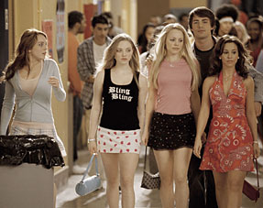
Peer pressure
You don’t have to SACRIFICE your beliefs for other people.
Follow your beliefs with INTEGRITY.
“Don’t be afraid to the army of me.”
-Bjork, Army of Me

Slide 4
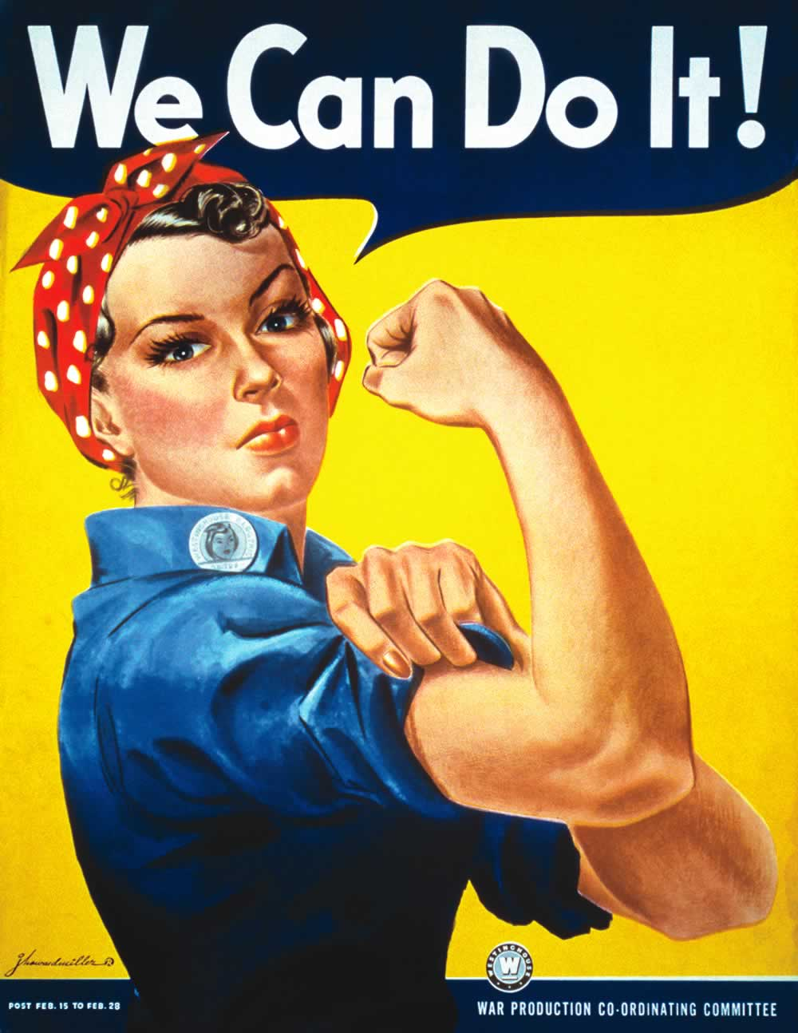
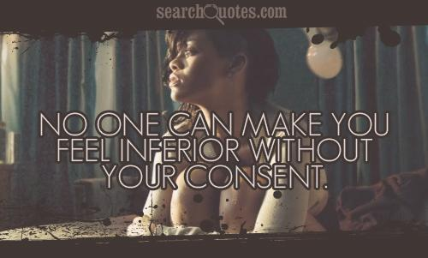
I AM POWERFUL
God put you in this situation because he knows you can handle it.
What doesn’t kill you will make you STRONGER.
Keep a high self-esteem and a positive image. You are always CAPABLE.
Notes:
Kelly Clarkson

Slide 5
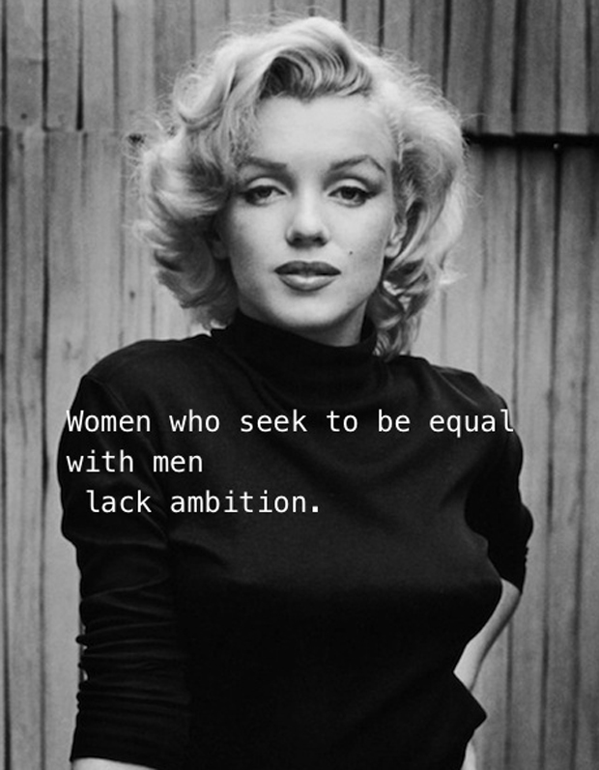
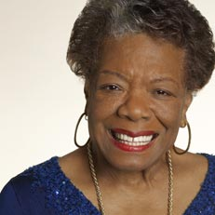
Love yourself
Everyone has their off days but you have to remember that you are still AMAZING at the end of the day.
Don’t let the negative events in your past define you today.
I’m a woman Phenomenally. Phenomenal woman, That’s me.
-Maya Angelou

